Slide 1

MBA European Management
Tailor-Made European Management for
Practitioners, Academics and International Students
Univ.-Prof. Dr. Bastian Popp
Academic Director
Univ.-Prof. Dr. Andrea Gröppel-Klein
Academic Director
www.eiabm.de | info@mba-europe.de | Saarland University | Campus A5 4 | 66123 Saarbrücken | Germany
Notes:
Emma and Jacob have great ambitions. They have received their first university degrees, they both have jobs and they are planning their family lifes. And why not go for even more? So the two of them decide to develop their knowledge in management and business to prepare for a career on top management level in business administration. With its
tailor-made MBA programme "European Management", the European Institute for Advanced Behavioural Management offers Emma and Jacob an excellent opportunity to achieve their goals and become leaders of the future.
Good morning ladies and gentlemen, my name is Bastian Popp and I am the Director of the European Institute for Advanced Behavioural Management and I am very delighted to welcome consul-general Parkar at our Institute.
It is a great pleasure for me to give you some insights into our institute and our links to India.

Slide 2
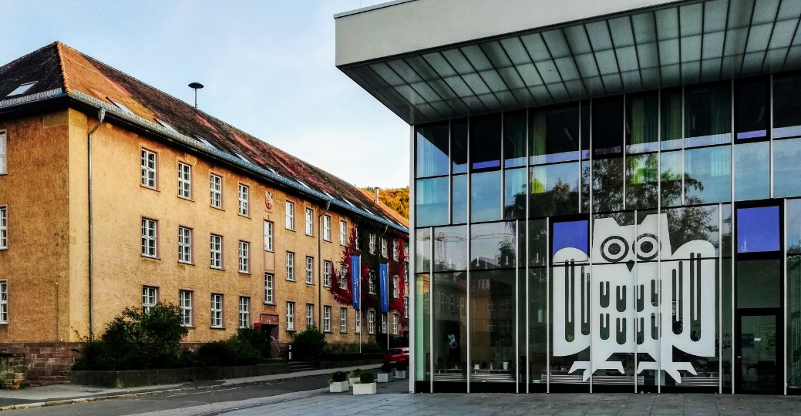
Key Facts
Postgraduate MBA study programme “European Management”
Full-time (1 year) or part-time (up to 4 years)
Benefit from excellent education from internationally renowned experts
Experience our “international weeks”
Focus on Behavioural Management
Understand how and why people and markets act like the way they do
“Managing with(in) Europe”
Qualification for leading positions on the international job market around the world
Take your management skills to the next level
Qualify for your management career
Earn an MBA in European Management
MBA European Management | www.eiabm.de

Slide 3
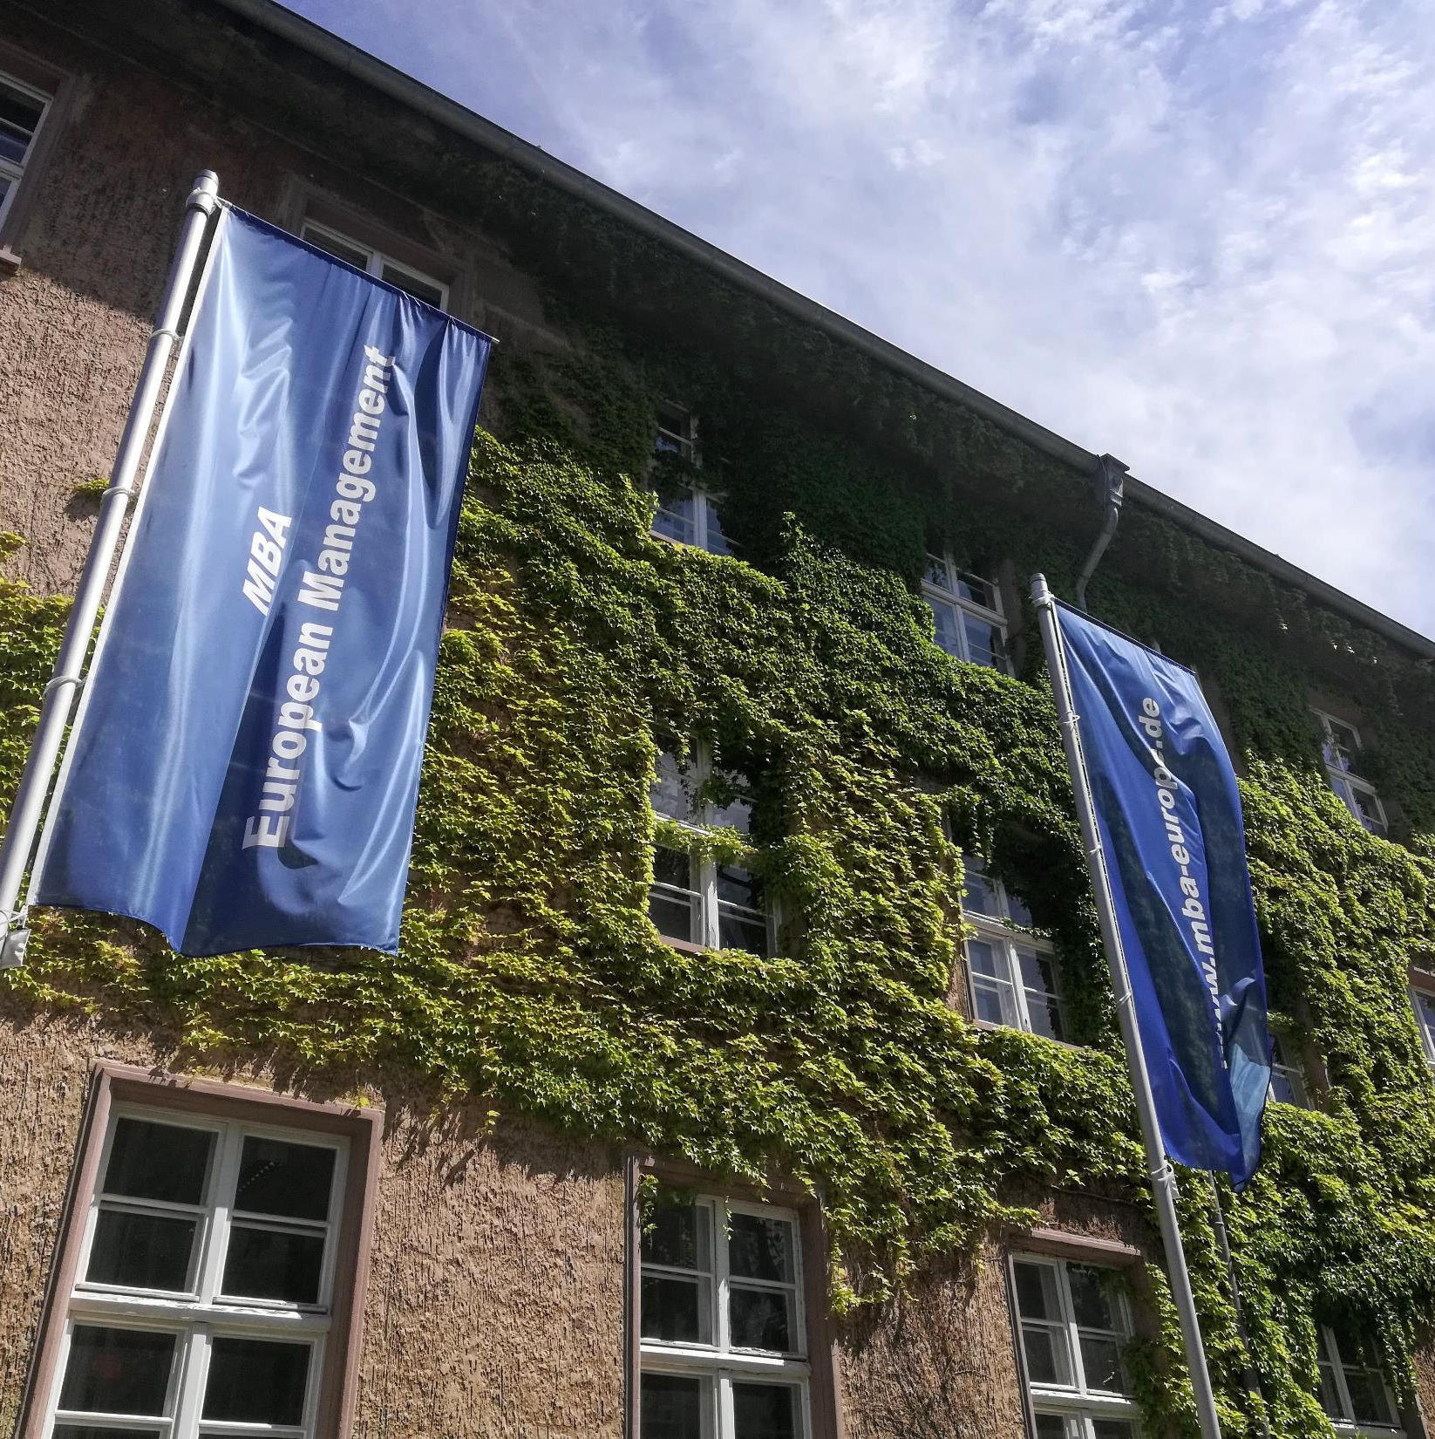
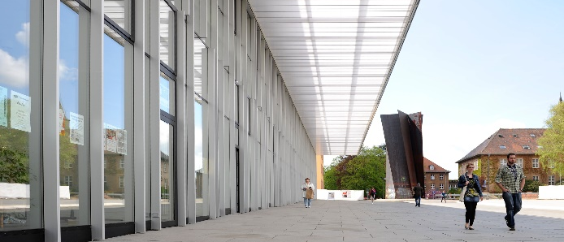
The European Institute for Advanced Behavioural Management (EIABM)
The EIABM is part of Saarland University located in Saarbrücken.
It’s the Business Section of the Europa-Institut.
The institute has a long-standing tradition in postgraduate teaching. Its MBA programme is the oldest MBA programme in all of Germany.
MBA European Management | www.eiabm.de

Slide 4
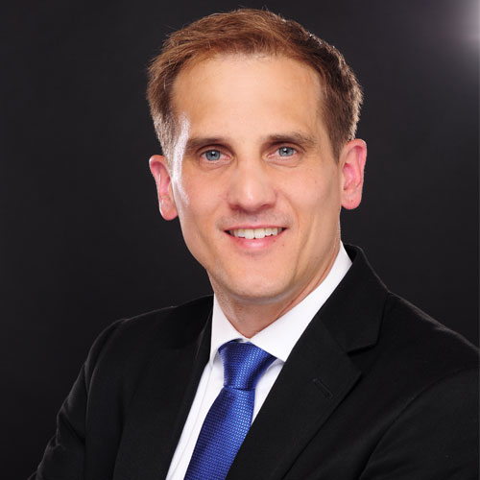
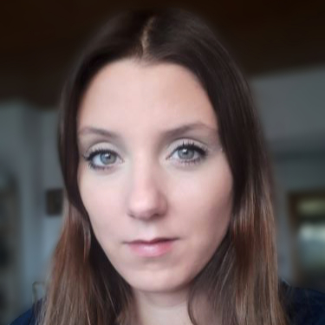
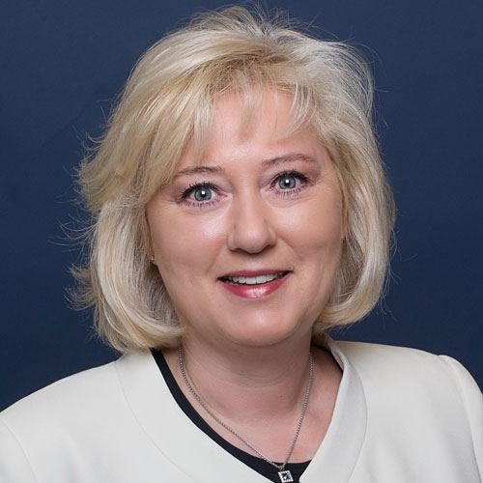
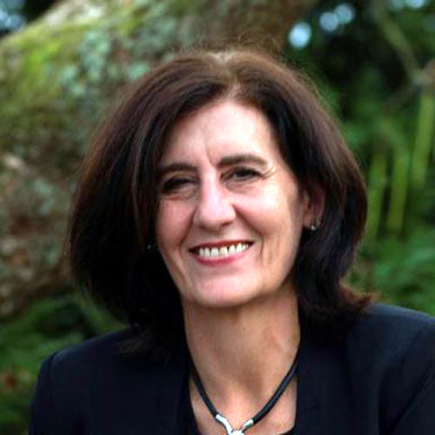
Team EIABM
Univ.-Prof. Dr. Bastian Popp
Academic Director
Institut für Handel &
internationales Marketing /
Chair of Retail Management
Julia Senni, M.A.
Programme Manager
Univ.-Prof. Dr. Andrea Gröppel-Klein
Academic Director
Institut für Konsum- und
Verhaltensforschung /
Chair of Marketing
Claudia Jamhour
Office
MBA European Management | www.eiabm.de

Slide 5

Managing with(in) Europe
Behavioural Management at the Heart of Europe!
Border triangle of Germany, France and Luxemburg provides a
unique study experience at the heart of Europe.
Qualification for leading positions on the
international job market around the world.
“Managing with(in) Europe” deals with
…all the operational and strategic activities
that need to be dealt with by companies
working within Europe.
…the challenges facing companies from
outside Europe who want to do business in and with Europe.
MBA European Management | www.eiabm.de

Slide 6
Characteristics of the MBA Programme
Excellent Quality Content
Essential fields of Management with a focus on Behavioural Management, high degree of practical relevance
Internationality
15 courses covering all management topics including political, legal, economic & cultural aspects
Flexibility
Full-time (1 year) or Part-time (max. 4 years)
Great Learning Environment
Online courses until the end of the winter term
High Learning Focus
Courses run 4 days each (exam or paper afterwards)
MBA European Management | www.eiabm.de

Slide 7
Module Overview
Module 1: Management Basics
M1-1 Strategic Management
M1-2 Corporate Sustainability and Social Responsibility
M1-3 Soft Skills
Module 2: European Basics
M2-1 European Institutions
M2-2 European Regulations
Module 3: Financial Management
M3-1 Economics and Finance
M3-2 Learning Business by Doing Business
Module 4: Marketing & Management
M4-1 Marketing and Management in Foreign Countries
M4-2 Retailing and Logistics
Module 5: Operations Basics
M5-1 Service Management
M5-2 Data Analysis
Module 6: Behavioural Management
M6-1 Consumer Behaviour
M6-2 Entrepreneurship
M6-3 Leadership and Human Resource Management
M6-4 Cross-Cultural Management
Module 7: Master Thesis
All courses can also be booked individually as certified advanced education courses !
MBA European Management | www.eiabm.de

Slide 8
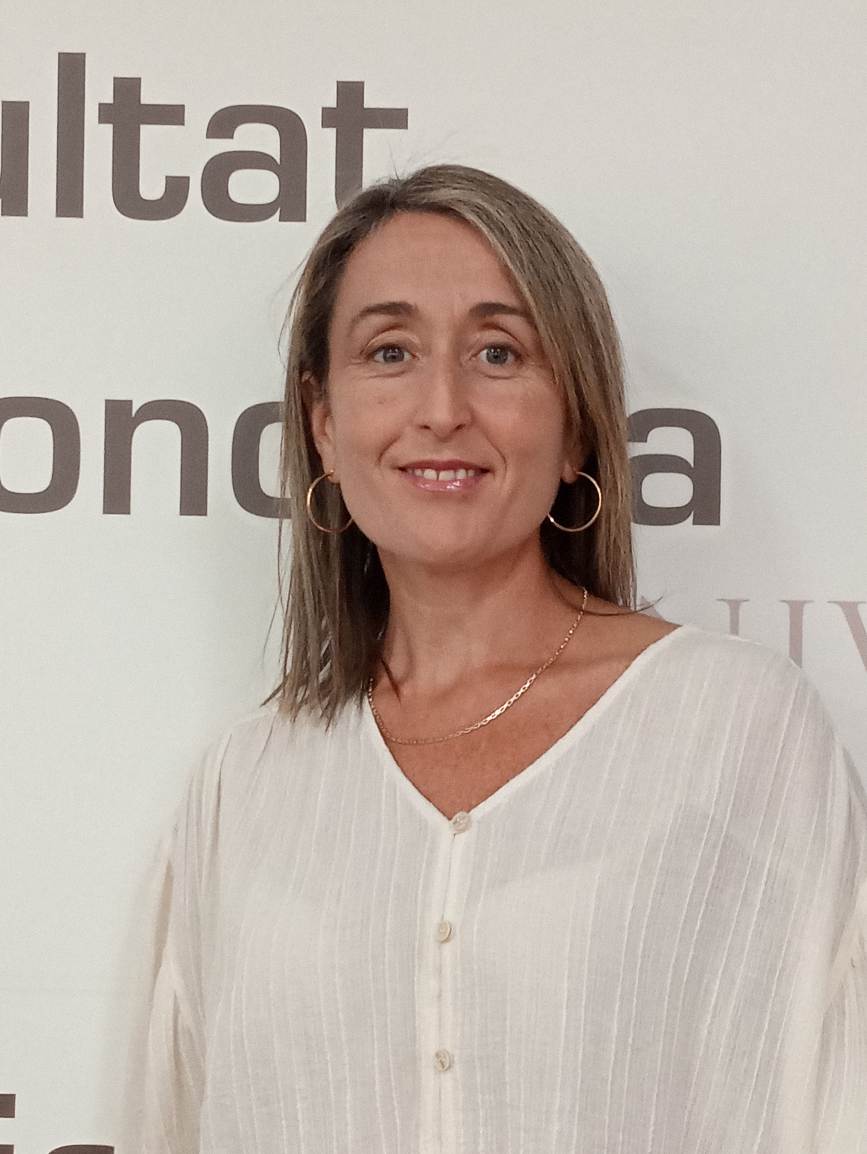

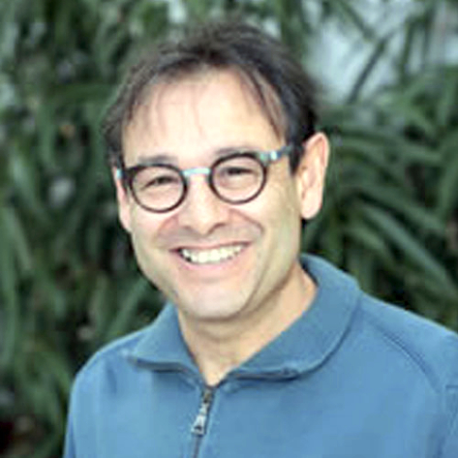
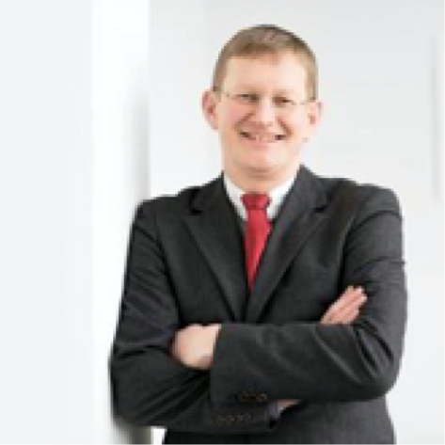

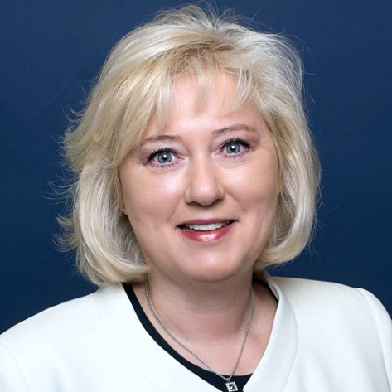
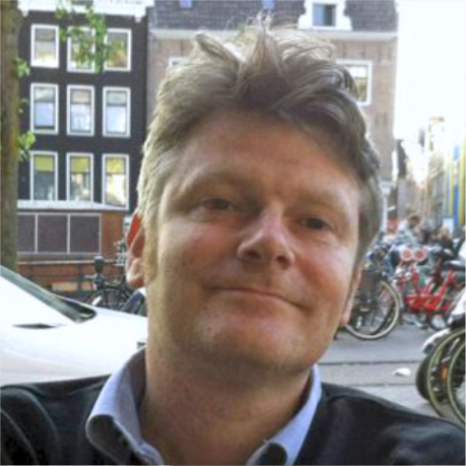
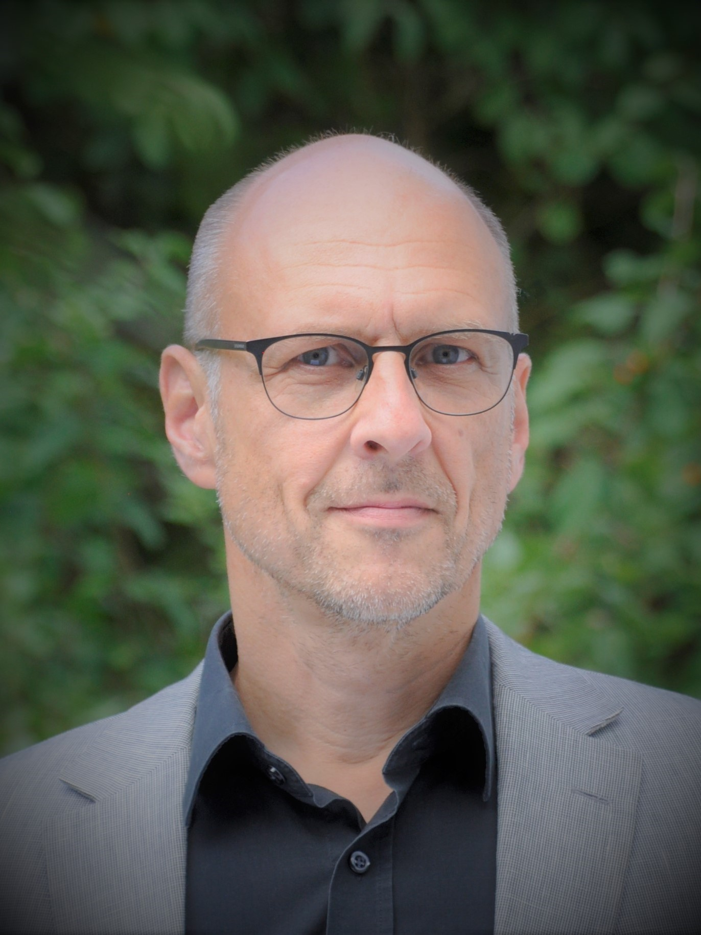
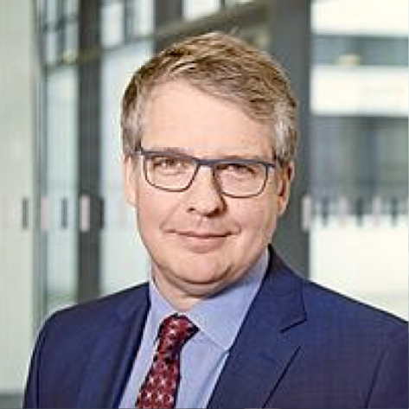
Professors and Lectureres (selected)
Prof. Luisa Andreu
University of Valencia
Univ.-Prof. Dr. Güliz Ger
Bilkent University
Dr. Emmanuel Zilberberg
ESCP Europe Business School
Prof. JUDr. Daniela Heid, Ph.D.
University of Siegen
Prof. Dr. Jan Wenzelburger
TU Kaiserslautern
Univ.-Prof. Dr. Andrea Gröppel-Klein
Saarland University
Dr. Dermot Breslin
University of Sheffield
Univ.-Prof. Dr.-Ing. Dr. Christian Berg
University of Kiel
Univ.-Prof. Dr. Dirk Temme
University of Wuppertal
MBA European Management | www.eiabm.de

Slide 9
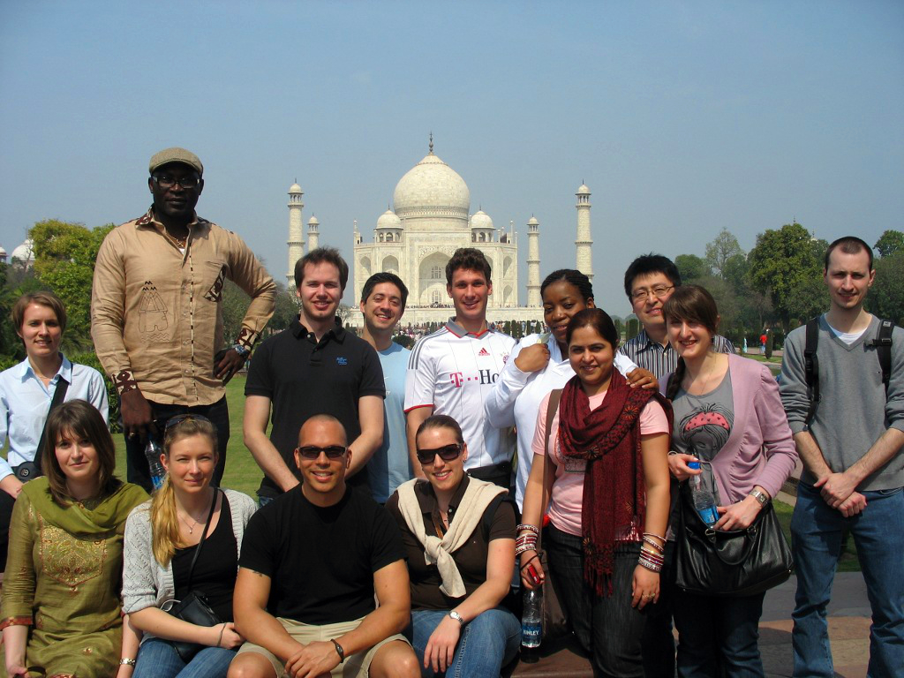
International Weeks
Experience 3 International Weeks with your fellow students !
Learn about management in other countries at first hand
Enhance your foreign language skills to professional level
Broaden your soft and intercultural skills
Get to know different cultures, lifestyles and mindsets
Have great fun with your fellow students
Partner universities and countries hosting international weeks:
  Sheffield (UK)
  Valencia (Spain)
  Rennes (France)
  Mysore (India)
  Fribourg (Switzerland)
  Craiova (Rumänien)
  São Paulo (Brasil)
  London (UK)
  Dublin (Ireland)
  Delhi (India)
  Rostov (Russland)
MBA European Management | www.eiabm.de

Slide 10






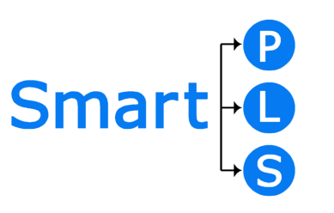



Flexible Teaching Methods
State-of-the-art teaching methods
Face-to-face classes as the standard is supplemented by distance learning
(if appropriate or necessary)
Provision and use of leading software
MBA European Management | www.eiabm.de

Slide 11
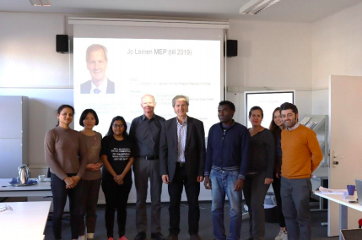
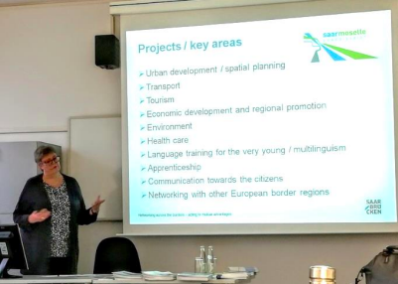
More than "just" Academic Courses...
Compelling guest speakers (e.g., Unilever, Selgros, Karlsberg)
Field trips and excursions (e.g., Goodyear, V&R, Michelin)
Case studies, interactive teamwork, real-life examples
MBA European Management | www.eiabm.de

Slide 12
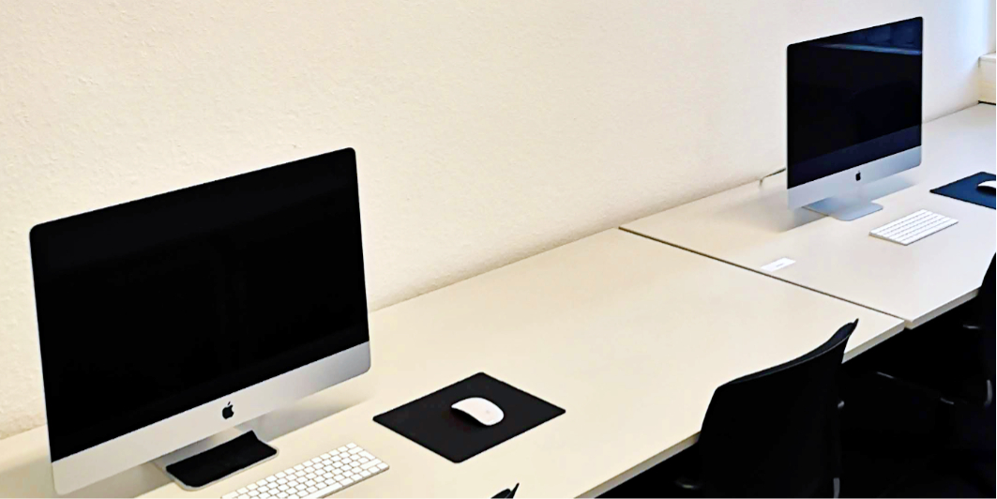
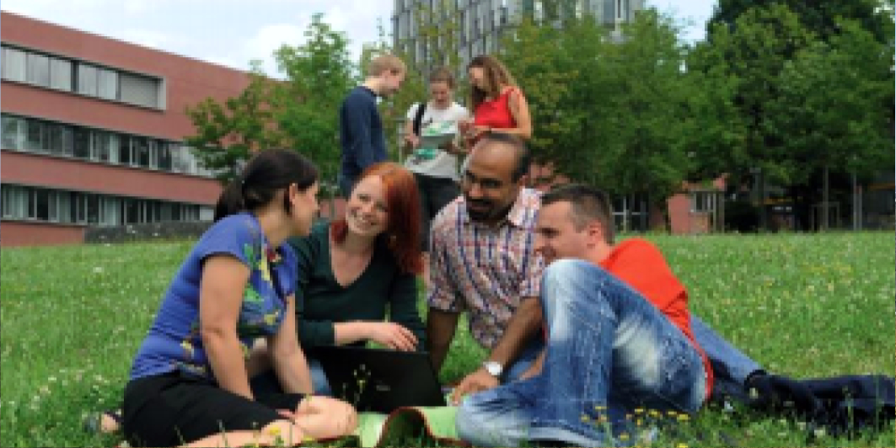
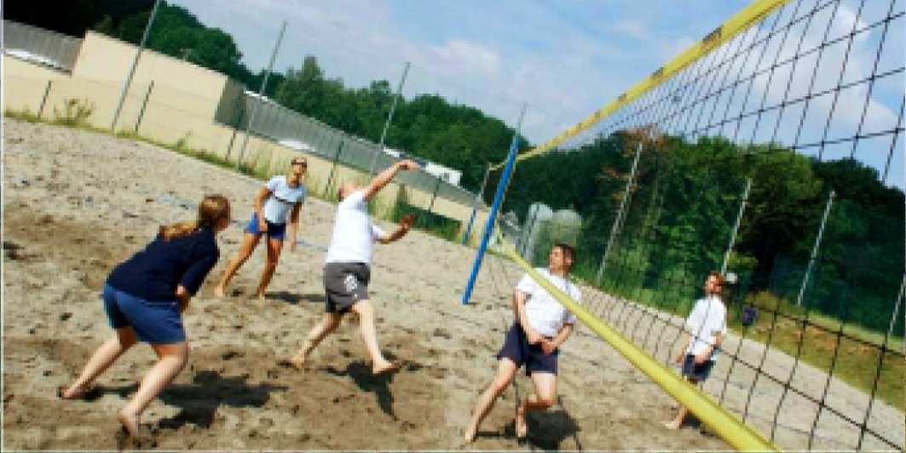
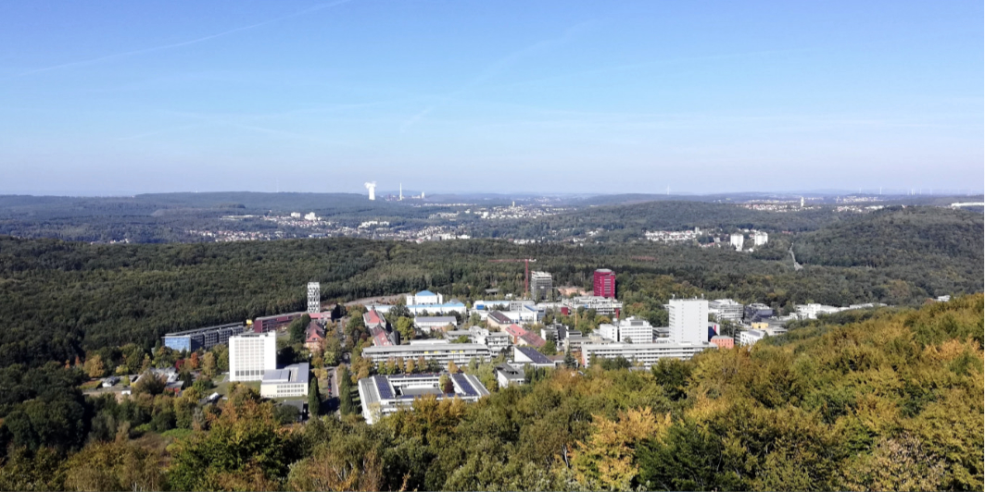
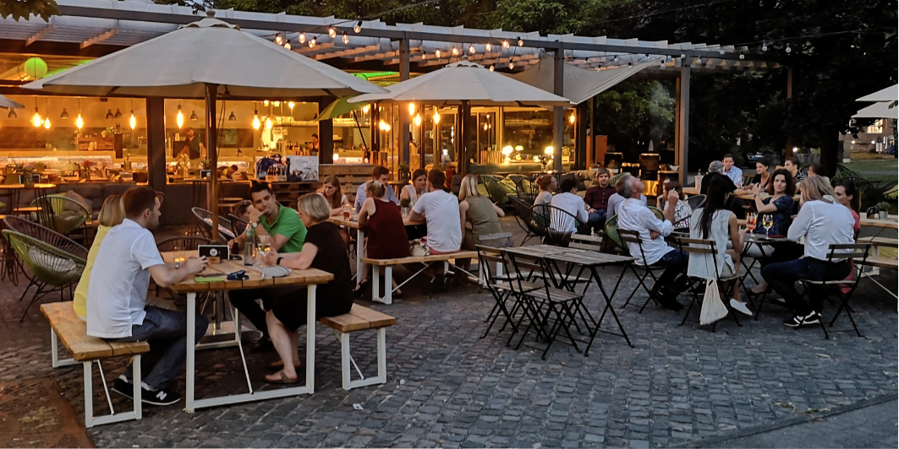
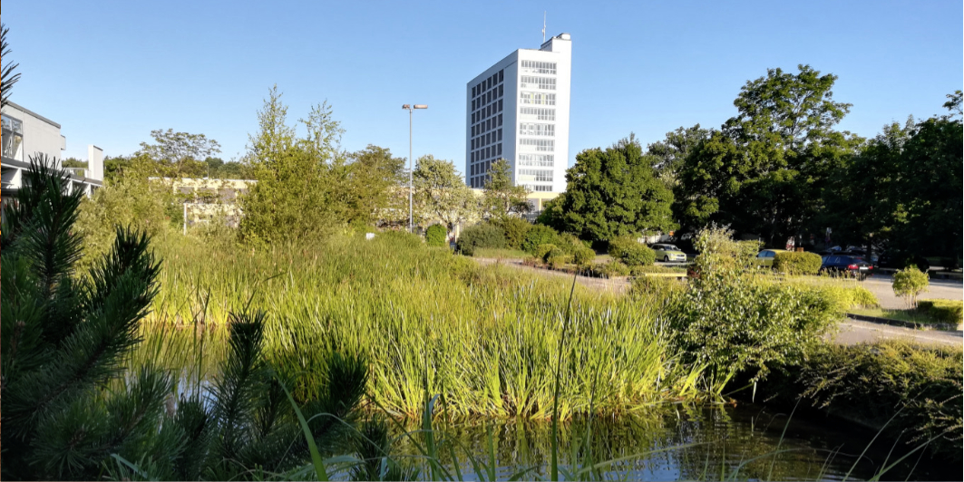
Study Environment
Use our facilities: Chill out in the Student Lounge or work together in our CIP Pool or enjoy the wonderful Campus of Saarland University!
MBA European Management | www.eiabm.de

Slide 13
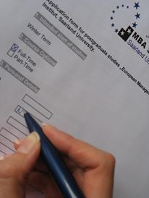
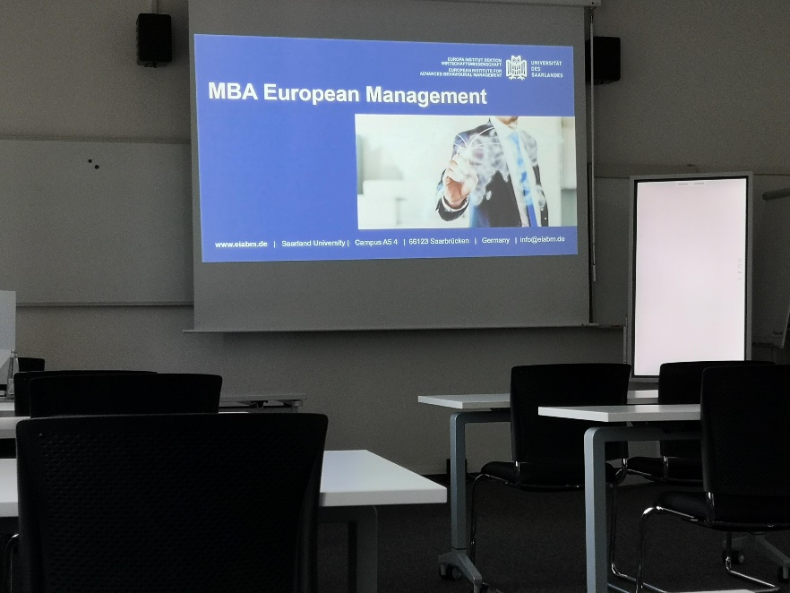
Admission to the MBA Programme
Postgraduate programme
Admission criteria:
  First university degree
  At least 1 year of post-graduate professional experience
  Language proof TOEFL or IELTS
  2 Letters of Recommendation
  GMAT (Graduate Management Admission Test)
  Motivation !
Study fees:
  Full-time study € 12,000
  Part-time study € 14,500
MBA European Management | www.eiabm.de

Slide 14
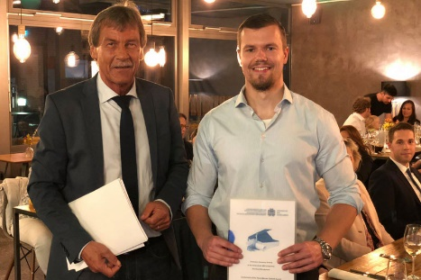
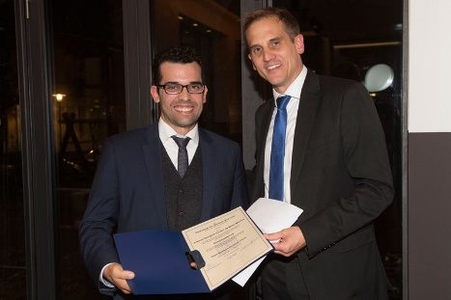
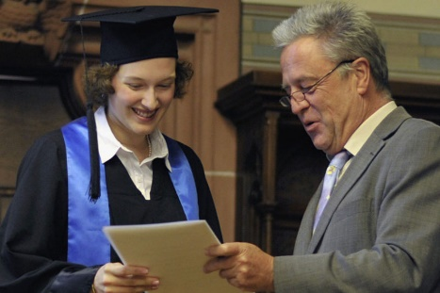
Funding, Awards and Scholarships
Various options for financial support and programme-related awards:
DAAD scholarships
Scholarship “Deutschlandstipendium“
UdS “BESTE-Preis“ (€ 1,000)
Villa Lessing Prize (€ 1,500)
Hans-Werner Osthoff Award (€ 1,500)
MBA European Management | www.eiabm.de

Slide 15
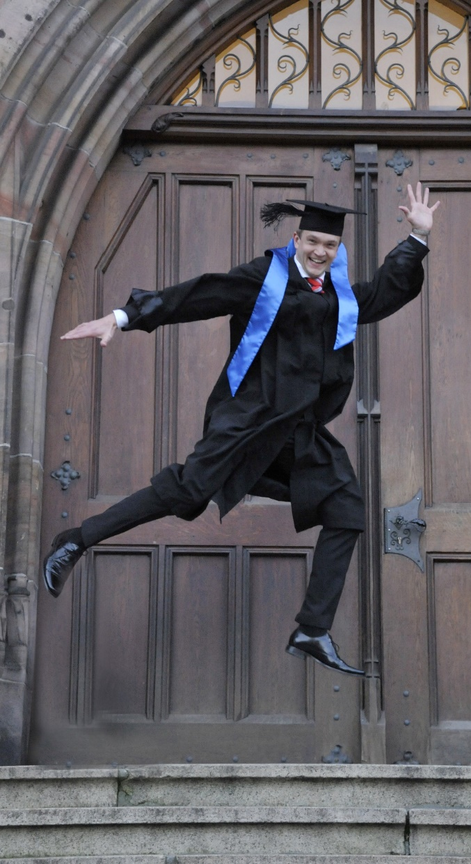
Where our Graduates are...
MBA European Management | www.eiabm.de

Slide 16

Who should apply?
Practitioners: You have a family, many responsibilities and are already working in a busy job with little time ? Get your MBA half-time within up to 4 years !
Entrepreneurs: You want to establish your own company or take the next step in your career ? Gain the know-how and an excellent qualification !
International students: You are an international student from another country ? Join our international team and get ready for your position at top management level !
Academics: You want to turn your academic professionalism
into a high-level position in the business world ? Put your
academic excellence to practice with your MBA !
MBA European Management | www.eiabm.de

Slide 17
Why choose our MBA European Management Programme?
Qualify for your International Management Career
Understand how and why people and markets act the way they do
Benefit from excellent education from internationally renowned experts
Learn in small groups
Case studies, real-life examples, practical exercises, team work, company visits
Interactive face-to-face and online exchange
Experience 3 International Weeks
Earn your MBA within 1 year full-time or up to 4 years half- time while working
MBA European Management | www.eiabm.de

Slide 18


MBA European Management
Your step to the future !
www.eiabm.de | info@mba-europe.de | Saarland University | Campus A5 4 | 66123 Saarbrücken | Germany

